Slide 1
Aufgabe 6
Reihe 2

Slide 2
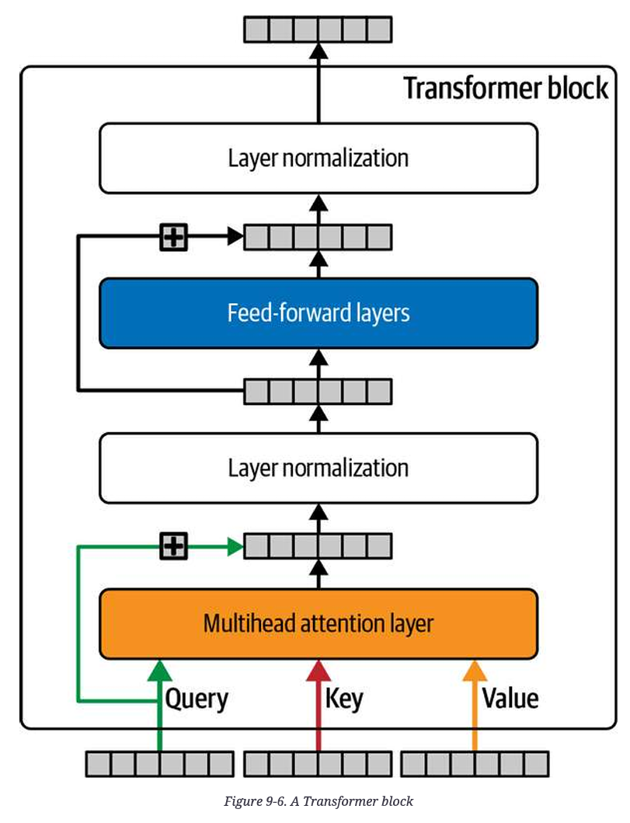
Inhaltsverzeichnis
Tokenizer
Token Embedding / Positional Embedding
Attention Head
Decoder Stack
Classification head
Token prediction

Slide 3
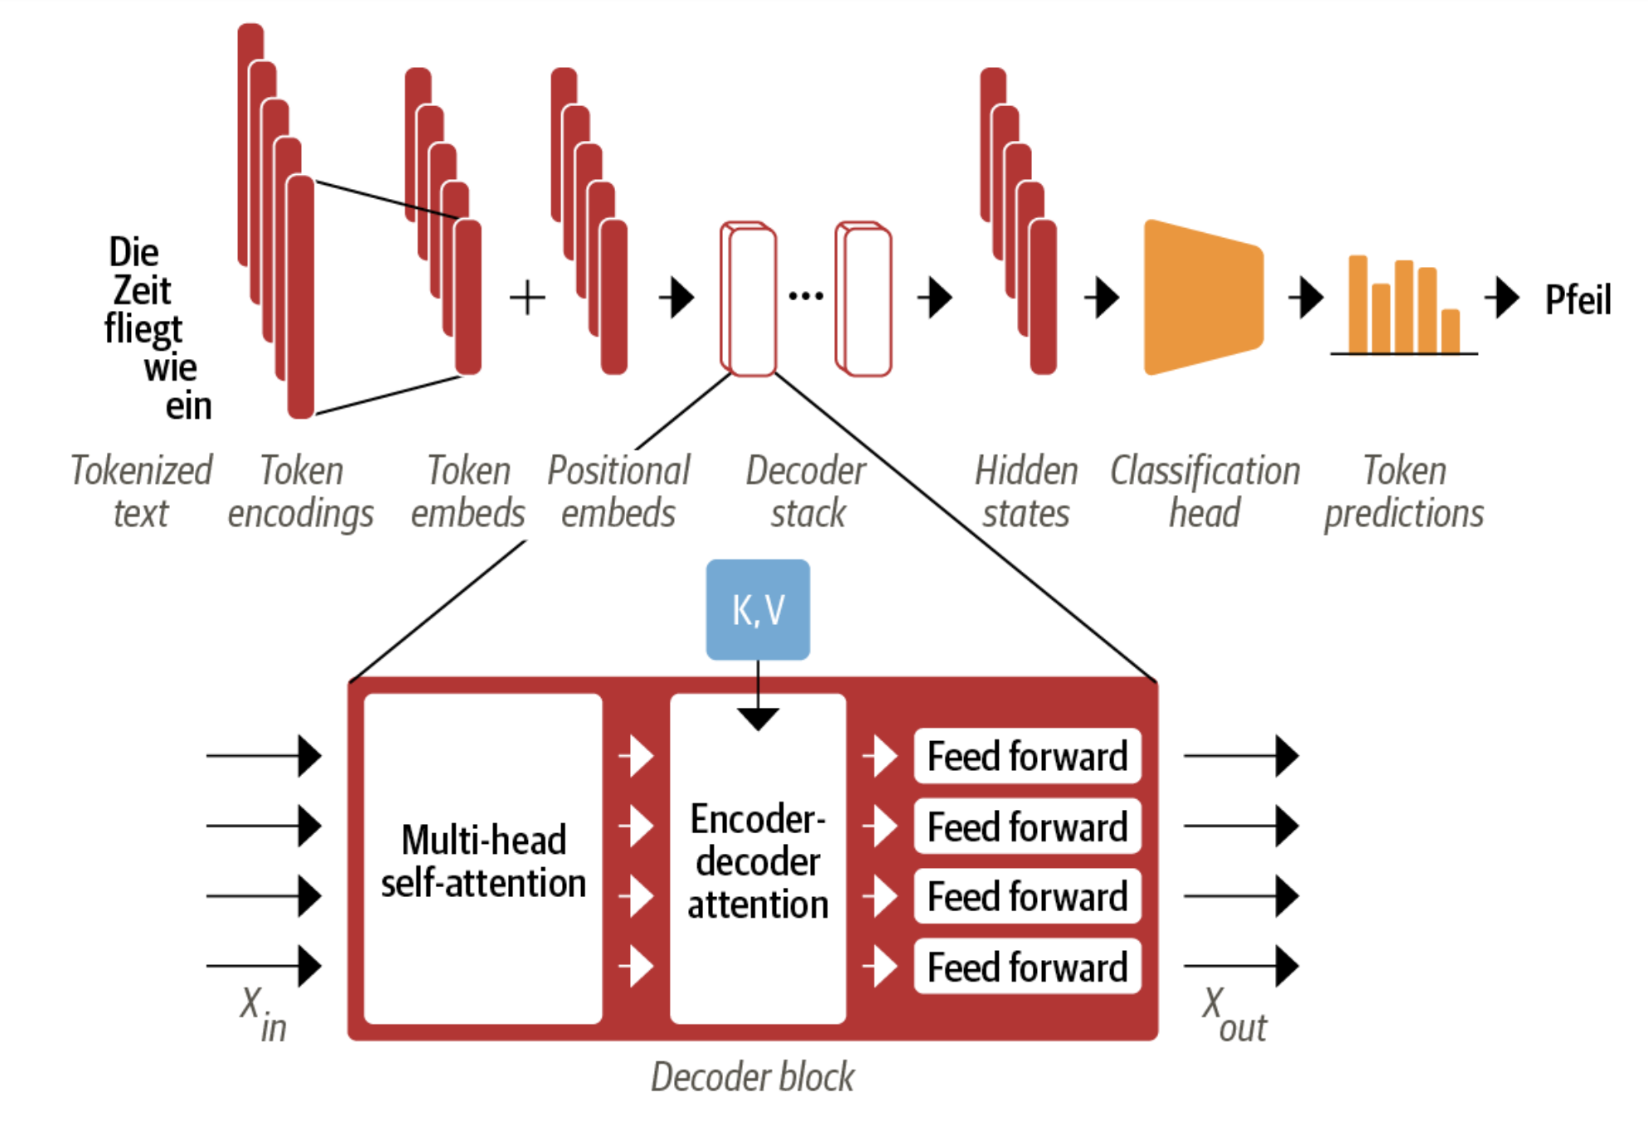

Slide 4
Tokenizer
Zeichenkette (Wort(-Teil) oder Buchstabe) wird in numerische Werte zerlegt
Eingabe wird durch Tokenizer normalisiert (Kleinschreibung, Satzzeichen entfernen, Wörter auf Wortstamm reduzieren (Stemming))
Token wird ein Index zugeordnet
Satz wird verlängert, um einheitliche Länge zu erreichen (Padding)
Verschiedene Tokenizer für verschiedene Anwendungsfälle
Tokenizer muss die jeweilige Sprache unterstützen (auch multi-language Tokenizer verfügbar)
Reservierte Tokens für spezielle Zeichen (Separator, Line Break)
Herausforderungen: Umgangssprache, Noise, Mehrdeutigkeit

Slide 5
Token Embedding / Positional Embedding (PZ)
Token Embedding
=> capture the most nuance, connections, and semantic meanings between tokens
Warum ?
Embeddings können viel mehr Informationen über Tokens, deren Zusammenhänge, deren Ähnlichkeiten, deren Inhalt beinhalten als reine Token
Positional Embedding
=> Reflects the order of the tokens
Warum?
Der Hund schaut den Jungen an und….
Der Junge schaut den Hund an und…
Die Position der Wörter bzw. Tokens ist wichtig für das Verständniss und die Vorhersage

Slide 6
Token Embedding / Positional Embedding (PZ)
Positional Embedding hat meistens den gleichen Shape wie das Token Embedding (muss es aber nicht haben)
Wenn die beiden Embeddings (Tensoren) die gleiche Länge haben, können sie einfach addiert werden
Embeddings sind die Wahren Inputs in LLM’s
Embeddings tragen zur grösse des Models bei
Embeddings sind, defacto, ein Supset der Gewichte des Models
Embeddings können klassisch Initialisiert werden oder von einem Pre-trainierten Model übernommen werden
Je besser die Embeddings sind, desto besser ist auch das Model

Slide 7
Token Embedding / Positional Embedding (PZ)
class TokenAndPositionEmbedding(layers.Layer):
def __init__(self, maxlen, vocab_size, embed_dim):
super(TokenAndPositionEmbedding, self).__init__()
self.maxlen = maxlen
self.vocab_size =vocab_size
self.embed_dim = embed_dim
self.token_emb = layers.Embedding(
input_dim=vocab_size, output_dim=embed_dim
)
self.pos_emb = layers.Embedding(input_dim=maxlen, output_dim=embed_dim)
def call(self, x):
maxlen = tf.shape(x)[-1]
positions = tf.range(start=0, limit=maxlen, delta=1)
positions = self.pos_emb(positions)
x = self.token_emb(x)
return x + positions

Slide 8
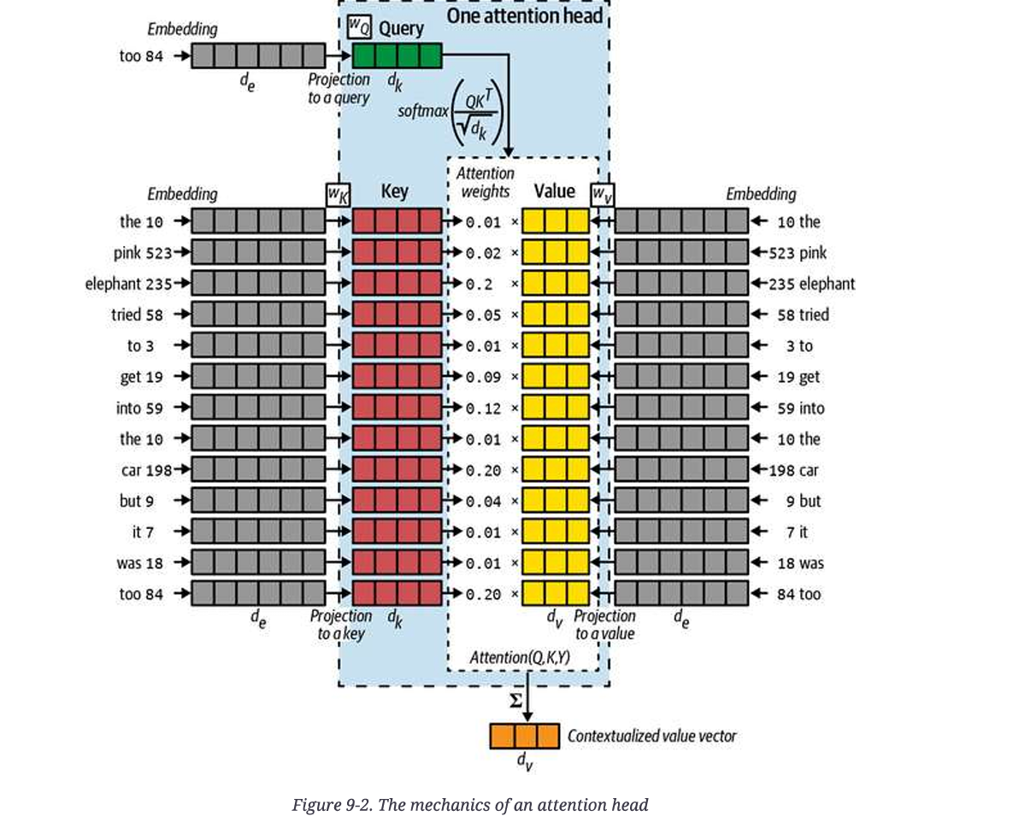
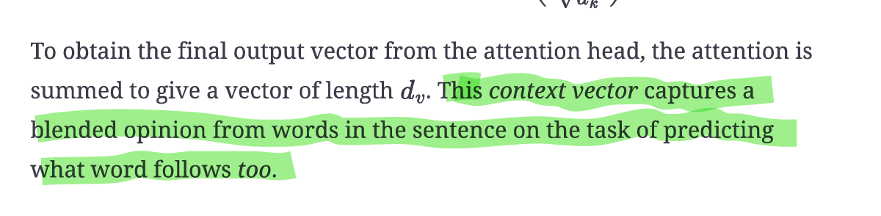
Attention Head
Was ist ein Attention Head?
Ein Attention Head ist wie ein Detektiv, der untersucht, wie Wörter in einem Satz miteinander verbunden sind..
Beispiel-Satz:
"Der Hund jagt die Katze, weil sie schnell ist."
Fragen stellen (Query): Jedes Wort fragt: „Was ist für mich wichtig?“
Beispiel: "sie" fragt: „Worauf beziehe ich mich?“
Angebote prüfen (Key): Alle Wörter bieten ihre Bedeutung an: „Das bin ich, beachte mich!“
Beispiel: "die Katze" sagt: „Ich bin die, die schnell ist.“
Antworten auswählen (Value): Der Attention Head entscheidet, welches Wort am wichtigsten ist.
Ergebnis: "sie" → "die Katze"
Warum mehrere Attention Heads?
Jeder Head hat eine Aufgabe:
Einer achtet auf Subjekte, z. B. "Der Hund".
Ein anderer achtet auf Verben, z. B. "jagt".
Gemeinsam verstehen sie den Satz besser!
Ein Attention Head hilft dem Modell:
Herauszufinden, welche Wörter wichtig sind.
Wörter und ihre Verbindungen im Kontext zu verstehen.

Slide 9
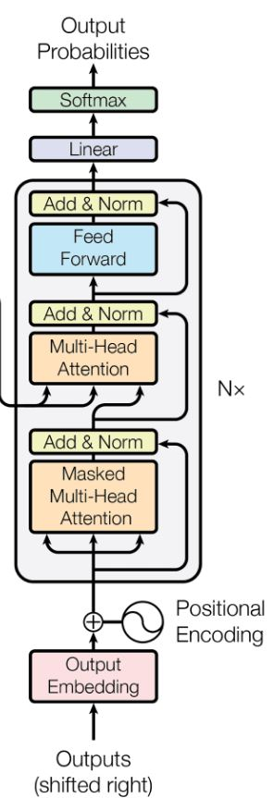
Decoder Stack (Roger)
The Decoder stack contains a number of Decoders. Each Decoder contains:
Two Multi-Head Attention layers
Feed-forward layer

Slide 10
Decoder Stack - Multi-Head Attention Layer
Multiple Attention Heads: Instead of having a single attention mechanism, multi-head attention uses several attention mechanisms, called heads. Each head processes the input data in parallel but focuses on different parts of the input sequence.
Parallel Processing: Each attention head performs its self-attention calculation independently, producing different representations of the same input sequence.
Concatenation: The outputs from all attention heads are concatenated (combined) into a single representation.
Linear Transformation: The concatenated output undergoes a linear transformation to blend the information from all heads.

Slide 11
Decoder Stack - Multi-Head Attention Layer
Components of Multi-Head Attention
Linear Layers: Yes, linear layers are used extensively to project the input data into different subspaces.
Query, Key, Value Projections: These are linear transformations to create queries, keys, and values from the input.
Output Projection: Another linear layer to combine the outputs from different heads.
Attention Mechanism: This is the core part of the Multi-Head Attention.
Scaled Dot-Product Attention: Computes the attention scores by taking the dot product of queries and keys, scaling by the square root of the dimension, and applying a softmax function to get the weights.
Concatenation and Final Linear Layer: After calculating the attention scores and generating the weighted sum of the values, the outputs from all heads are concatenated and passed through a final linear layer.

Slide 12
Decoder Stack - Multi-Head Attention Layer
Benefits
Multiple Perspectives: By having multiple heads, the model can learn different representations and capture various aspects of the input data. This is especially useful for understanding complex patterns in language.
Improved Accuracy: Multi-head attention allows the model to focus on different parts of the sequence simultaneously, leading to more accurate and nuanced representations.
Applications
Machine Translation: Helps in capturing different translations by focusing on various aspects of sentences.
Text Summarization: Extracts key information from lengthy documents by attending to multiple parts simultaneously.
Language Models: Used in models like BERT and GPT to improve understanding of context and relationships in text.

Slide 13
Decoder Stack - Feed-Forward Neural Network (FFN)
Two Linear Transformations: The feed-forward part consists of two fully connected linear layers with a ReLU activation function in between.
Layer 1: Takes the input from the attention mechanism and applies a linear transformation.
ReLU Activation: Introduces non-linearity, allowing the network to learn more complex patterns.
Layer 2: Applies another linear transformation to the output of the ReLU activation.
Independence Across Positions: Unlike the attention mechanism, which considers relationships between different positions in the input sequence, the feed-forward part processes each position independently.
Output: The transformed data is passed on to subsequent layers or returned as the final output of the model.

Slide 14
Decoder Stack - Why Masked Multi-Head Attention and Multi-Head Attention layers
Masked Multi-Head Attention
Purpose: Used primarily in the decoder part of the transformer architecture, especially during tasks like language generation.
Function: Masks out future tokens (words) in a sequence to prevent the model from "cheating" by looking ahead at future tokens when generating the current token. This ensures that predictions for the next word depend only on the words that have come before it.
Use Case: Essential for autoregressive tasks where the model generates text one token at a time, like in language models and text generation.
Masked Multi-Head Attention: Ensures the autoregressive property by masking future tokens, which is crucial for generating coherent and sequential text without future information.
Multi-Head Attention
Purpose: Used in both the encoder and decoder parts of the transformer architecture.
Function: Allows the model to attend to different parts of the input sequence to gather context, improving its understanding of relationships between tokens (words).
Use Case: In the encoder, it processes the entire input sequence to create a rich representation. In the decoder, it helps the model focus on relevant parts of the input sequence while generating output.
Multi-Head Attention: Provides the model with the ability to learn intricate relationships within the input data, enhancing its contextual understanding and overall performance.

Slide 15
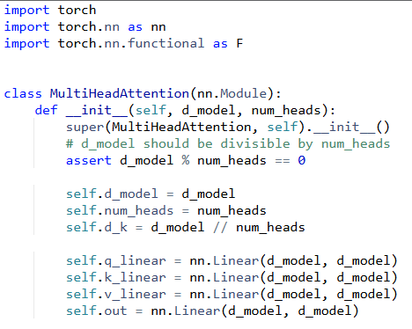
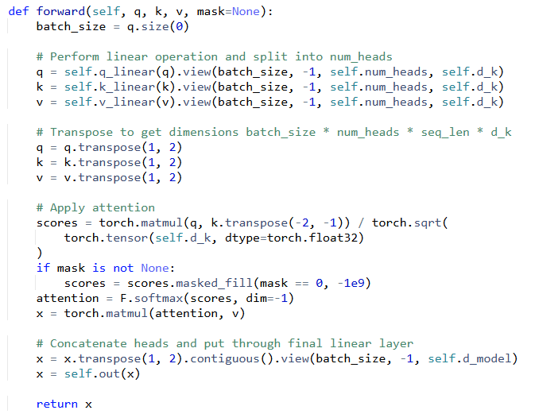
Decoder Stack - Why Masked Multi-Head Attention and Multi-Head Attention layers
Notes:
import torch
import torch.nn as nn
import torch.nn.functional as F
class MultiHeadAttention(nn.Module):
def __init__(self, d_model, num_heads):
super(MultiHeadAttention, self).__init__()
# d_model should be divisible by num_heads
assert d_model % num_heads == 0
self.d_model = d_model
self.num_heads = num_heads
self.d_k = d_model // num_heads
self.q_linear = nn.Linear(d_model, d_model)
self.k_linear = nn.Linear(d_model, d_model)
self.v_linear = nn.Linear(d_model, d_model)
self.out = nn.Linear(d_model, d_model)
def forward(self, q, k, v, mask=None):
batch_size = q.size(0)
# Perform linear operation and split into num_heads
q = self.q_linear(q).view(batch_size, -1, self.num_heads, self.d_k)
k = self.k_linear(k).view(batch_size, -1, self.num_heads, self.d_k)
v = self.v_linear(v).view(batch_size, -1, self.num_heads, self.d_k)
# Transpose to get dimensions batch_size * num_heads * seq_len * d_k
q = q.transpose(1, 2)
k = k.transpose(1, 2)
v = v.transpose(1, 2)
# Apply attention
scores = torch.matmul(q, k.transpose(-2, -1)) / torch.sqrt(
torch.tensor(self.d_k, dtype=torch.float32)
)
if mask is not None:
scores = scores.masked_fill(mask == 0, -1e9)
attention = F.softmax(scores, dim=-1)
x = torch.matmul(attention, v)
# Concatenate heads and put through final linear layer
x = x.transpose(1, 2).contiguous().view(batch_size, -1, self.d_model)
x = self.out(x)
return x

Slide 16
Classification head (EO)
The classification head is the final part of a neural network that takes the rich representations learned by the model (like a transformer) and converts them into specific classification outputs. Let me explain with an analogy and then get technical:
Analogy: Imagine you're a wine expert who has developed an incredibly sophisticated way of analysing wines (like the transformer backbone). But at the end, you need to make specific decisions: Is this wine red or white? What region is it from? The classification head is like your final decision-making process that takes all your detailed analysis and produces specific answers.
Basic Structure:
Takes the output representations from the transformer
Usually consists of one or more linear layers (matrices of weights)
Often includes an activation function (like softmax for multi-class classification)
Outputs probabilities or scores for each possible class
Language translation and equivalent services have been around for years but until recently they were not very good. The simplest method for translation was to use a dictionary and exchange one word for another. The problem with this is that it produces very bad translations because word order and usage differ dramatically between languages. Also most languages suffer from the one to many and many to one problem where there can be multiple words that share the same translation into a single word or many words that could be used from a single query. Some languages have nouns with genders which can create strange translations. For example one would not translate "Je suis allé à Paris l'été dernier. Elle était belle" as "I went to Paris last summer. She was beautiful"
A transformer attempts to understand the context of the sentence and then map that into the appropriate context in the target language. It does this by attempting to identify the most likely use cases given a prior knowledge of how words in a vast library of background data are usually associated.
When text enters a transformer, it's first converted into numbers (tokens) Each word or subword gets turned into a vector (a list of numbers) through "embeddings". The model also adds "positional encodings" to these vectors so it knows where each word appears in the sequence.
For each word, the transformer creates three versions: Query, Key, and Value vectors.
Think of Query as "what am I looking for?", Key as "what do I contain?", and Value as "what information do I provide?"
For each word, the transformer takes its Query and compares it to all other words' Keys and calculates how much attention to pay to each other word Uses these attention scores to create a weighted sum of the Values.
After the attention step, each word's representation goes through a standard neural network which processes each word independently in an attempt to learn more complex patterns.
The text is processed in multiple ways, called "heads” to consider different interpretations a bit like asking several people for their perspectives on the same text. Each "head" can focus on different types of relationships- Some heads might focus on grammar, others on topic, etc.
During training, some words may be masked and the model will be forced to predict them. This can then be compared to a known truth from the original unmasked text. The model learns to use context to make these predictions better.
Attention scores are normalised using softmax function

Slide 17
Token prediction - Eine einfache Einführung (MAC)
Für den Dilettanten Token Prediction in Transformers ist der Prozess, in dem ein KI-Modell den nächsten Baustein (z. B. ein Wort) in einer Folge “errät”. Dazu werden dem Modell eine Folge von z.B. Text-Bausteinen übergeben, welche das Modell versteht und daraus das Wort mit der höchsten Wahrscheinlichkeit hinzufügt. Beispiel: Wenn du sagst "Die Katze sitzt auf dem", wird das Modell zum Beispiel "Baum" oder "Sofa" als nächstes Wort vorschlagen.
Für den Experten Token Prediction in Transformers basiert auf der Verarbeitung des Kontextes der bereits übergebenen Folge durch Eigen- / Kontextaufmerksamkeit (Self-Attention). Das Modell berechnet, wie stark jedes Token mit anderen in der Sequenz zusammenhängt. Im autoregressiven Modus (z. B. GPT) wird die Wahrscheinlichkeit des nächsten Tokens P(xt+1∣x1,x2,...,xt)P(x_{t+1} | x_1, x_2, ..., x_t)P(xt+1​∣x1​,x2​,...,xt​) basierend auf vorherigen Tokens maximiert. In maskierten Modellen (z. B. BERT) wird ein verborgenes Token aus dem gesamten Kontext rekonstruiert.

Slide 18
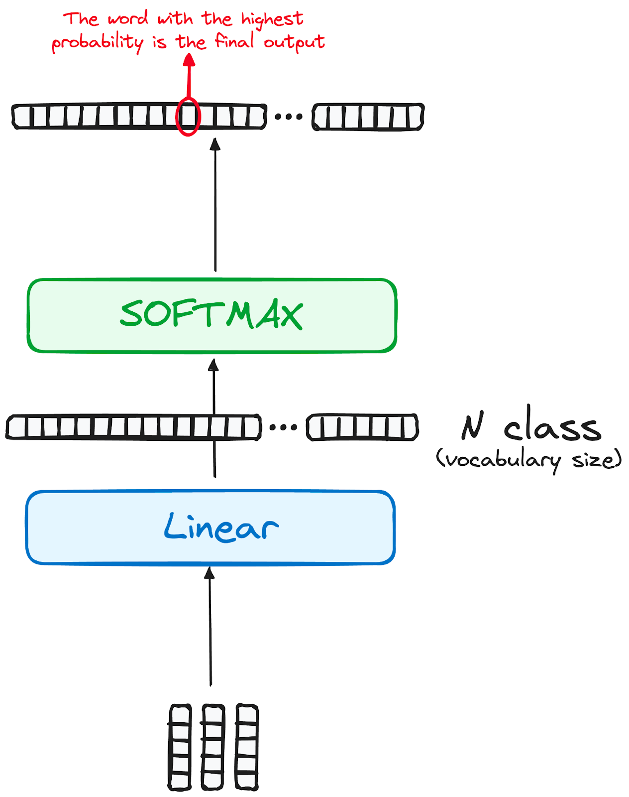
Token prediction - Daten / Algorithmus (MAC)
Linearer Klassifikator und Softmax zur Erzeugung der Ausgabewahrscheinlichkeiten
Zuerst fliessen die Daten aus dem Transformermodell durch eine lineare Schicht, die als Klassifikator fungiert.
Die Größe des Klassifikators entspricht der Gesamtzahl der Klassen (Anzahl der im Vokabular enthaltenen Wörter). In einem Szenario mit 1000 verschiedenen Klassen, die 1000 verschiedene Wörter repräsentieren, ist die Ausgabe des Klassifikators ein Array mit 1000 Elementen.
Der Output wird Softmax übergebe, um eine Reihe von Wahrscheinlichkeitswerten (0 und 1) zu generieren. Der höchste dieser Wahrscheinlichkeitswerte ist der Schlüssel zum nächsten Token bzw. Wort im Kontext NLP.

Slide 19
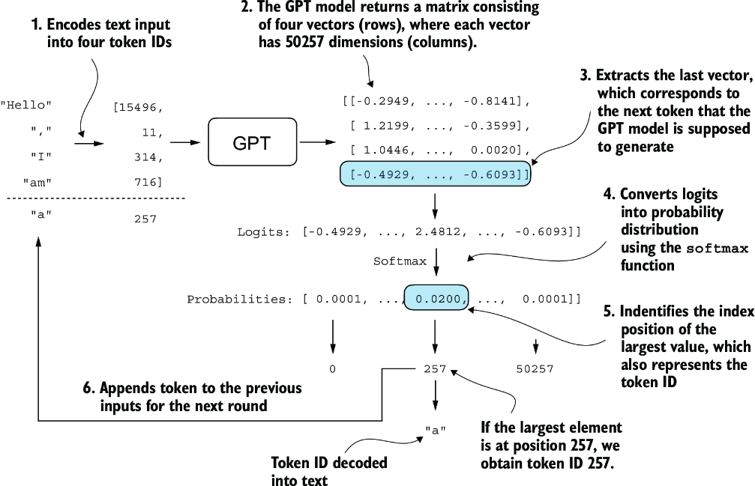
Token prediction - Daten / Algorithmus (MAC)

